Slide 1

Unshackled Manhood: Faith in the Deepest Dungeon
Introduction: Acts 16:16-40
The Hook: Character shows when life hits hard, not when things go well.
Context: They freed a slave girl — and got beaten, humiliated, and jailed for it.
The Big Idea: God seeks men who worship through suffering, not around it.

Slide 2
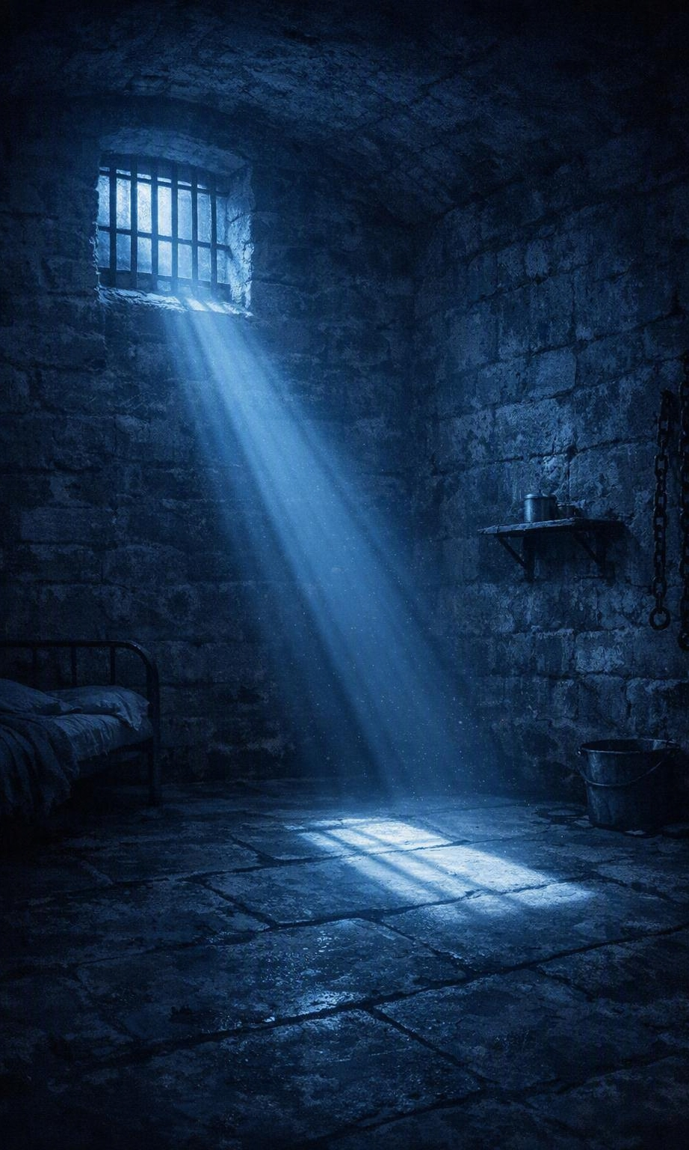
1. A Man Leads with Worship in the Dark (Acts 16:25)
The Text: "About midnight Paul and Silas were praying and singing hymns to God…"
The Reality: Bleeding and bound, they praised before their circumstances changed.
The Application for Men:
  Midnight = financial stress, marriage strain, health scares.
  Passive men numb out; leaders choose praise over pity.
  Your family is watching how you handle the dark.

Slide 3
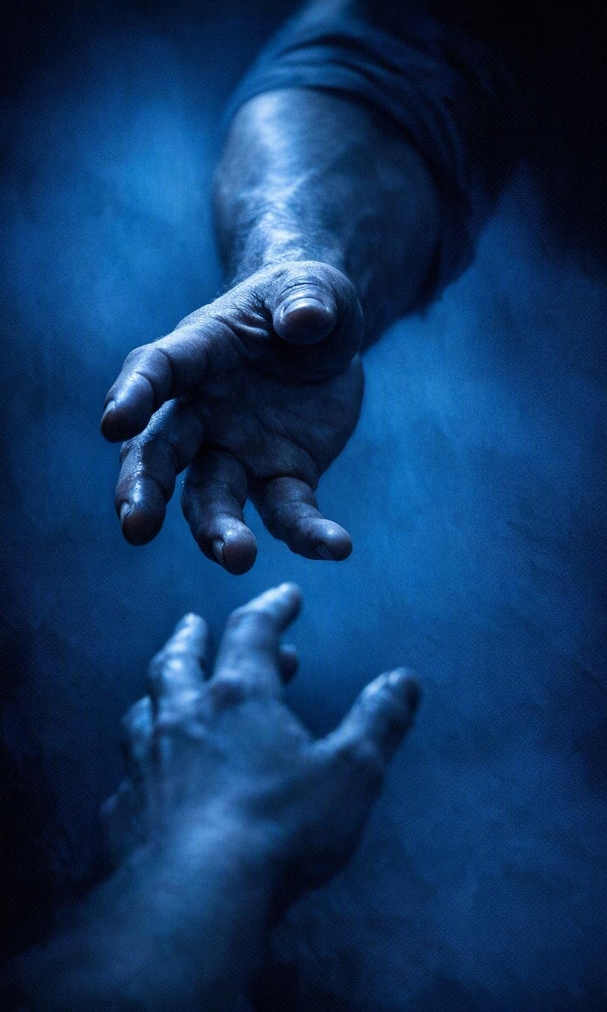
2. A Man Protects and Serves His Enemy (Acts 16:27-28)
The Text: The jailer drew his sword; Paul shouted, "Don't harm yourself! We are all here!"
The Reality: Their oppressor "deserved" revenge — they chose a higher code.
The Application for Men:
  Value human life over vengeance or convenience.
  Real strength is restraint.
  Speak life into the desperate people around you.

Slide 4
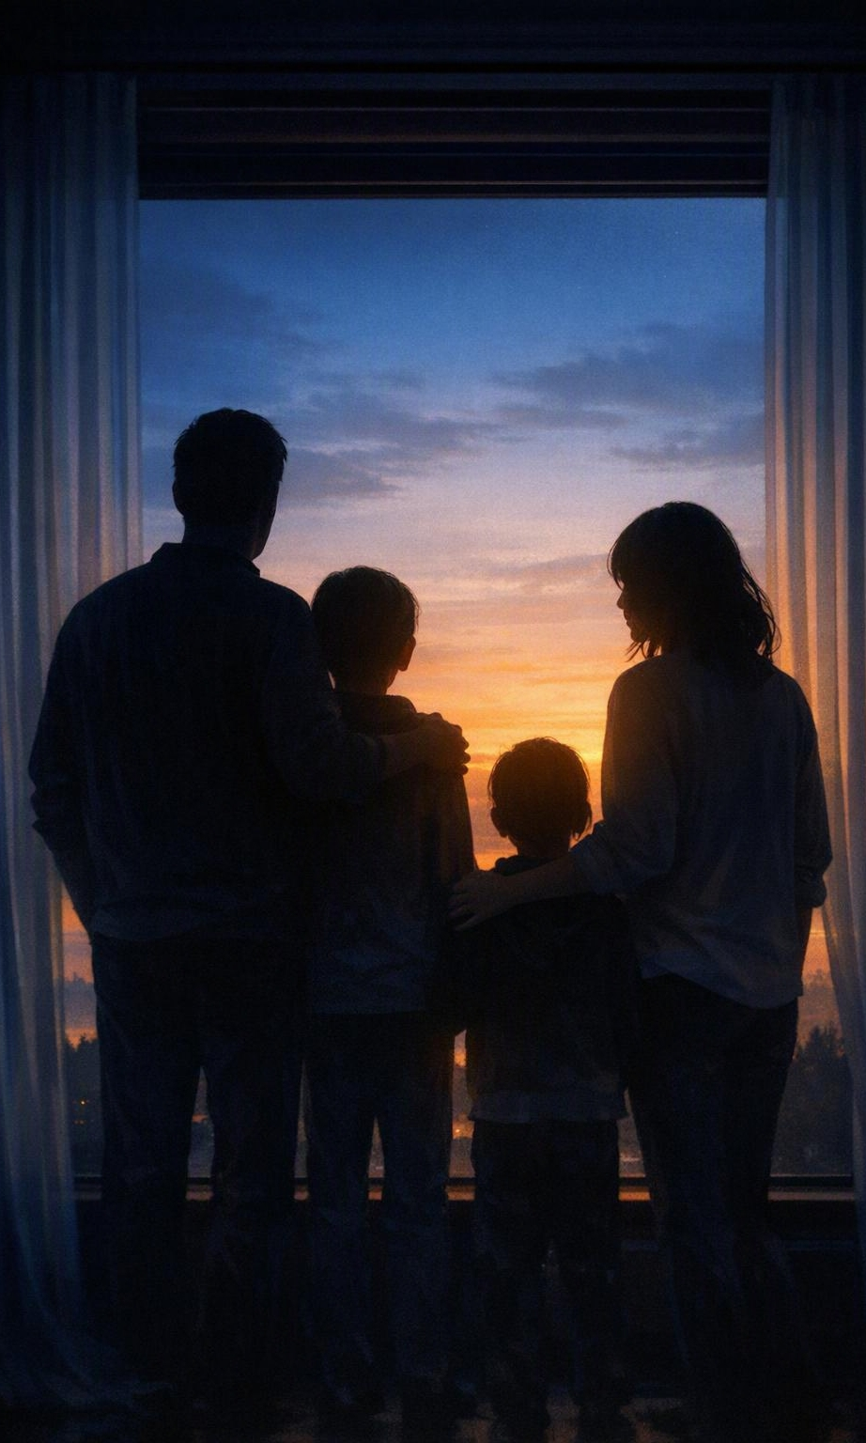
3. A Man Reclaims His Household for God (Acts 16:29-34)
The Text: "What must I do to be saved?" — he and his whole household were baptized at once.
The Reality: One man's conversion changed his entire family's trajectory.
The Application for Men:
  You are the spiritual gatekeeper of your home.
  One surrender ripples through wife, kids, and legacy.
  True leadership serves — he washed their wounds and fed them.

Slide 5
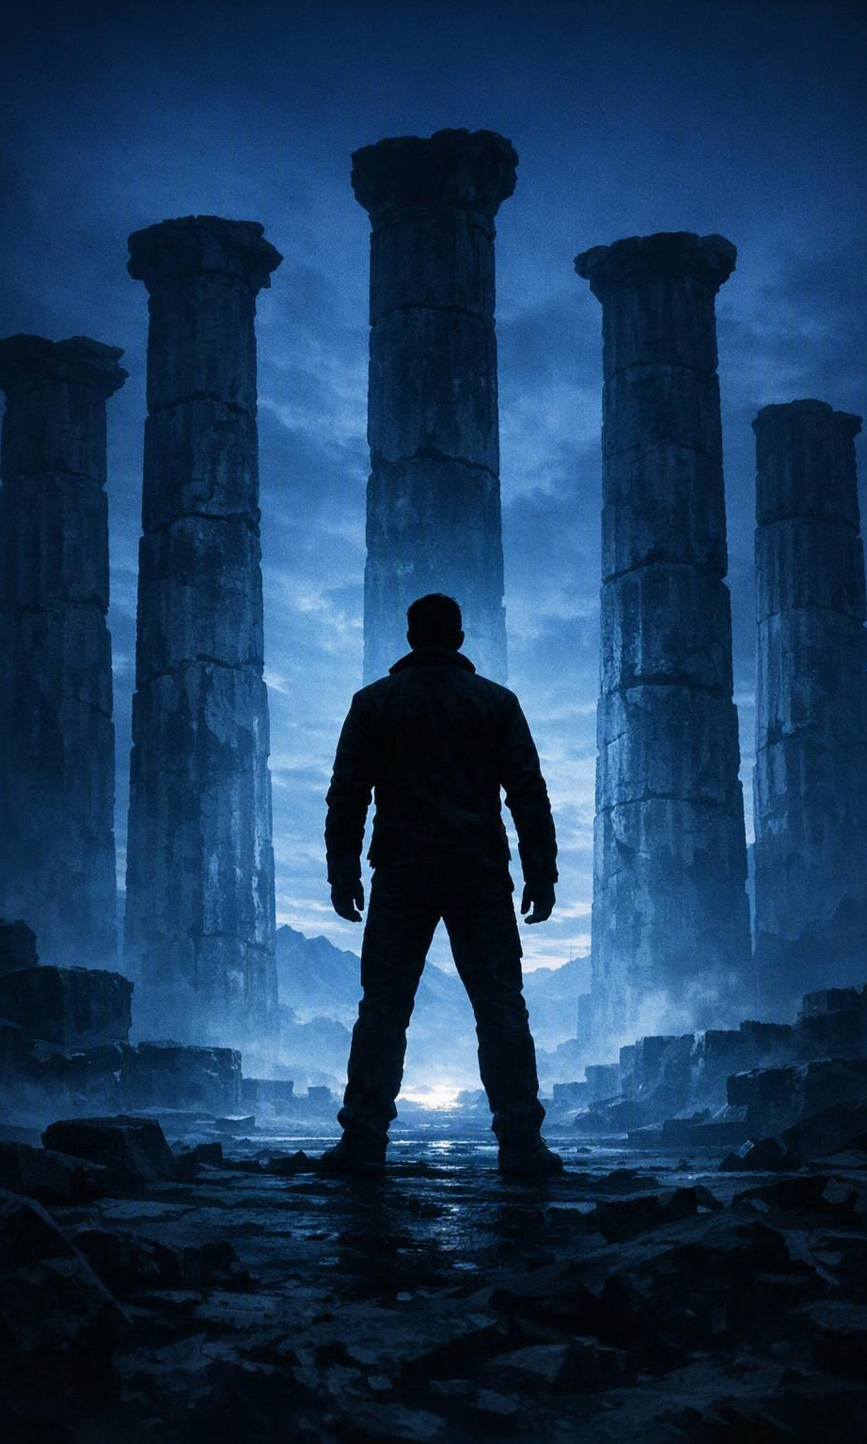
4. A Man Stands Tall and Demands Integrity (Acts 16:35-39)
The Text: Paul refused a quiet release: "Let them come and escort us out."
The Reality: A Roman citizen beaten without trial, he shielded the young church from a criminal label.
The Application for Men:
  Don't let injustice be swept under the rug.
  Know the time for endurance and for confrontation.
  Use your voice and standing to protect the vulnerable.

Slide 6
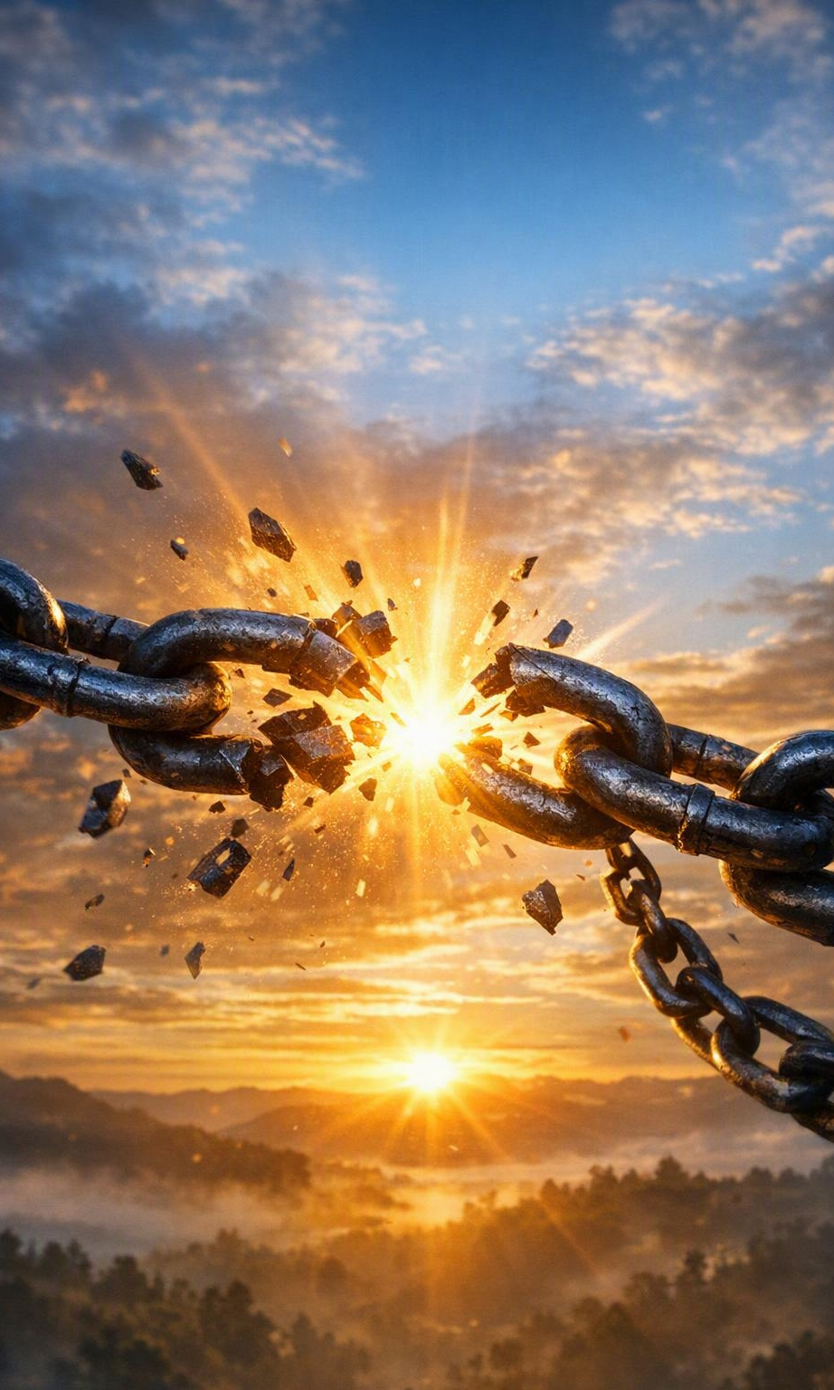
In Closing:
The Call to Action: What dungeon are you in today? Stop waiting for the earthquake.
The Challenge:
  Start singing in your midnight.
  Lead your home with bold faith.
  Stand firm as a citizen of God's Kingdom.

