Slide 1


Contend for the Faith
SCRIPTURE & SERMON NOTES
A study companion to Jude 3 — with cross-references and room for notes
Scripture quotations from the New King James Version®. © 1982 Thomas Nelson.

Slide 2
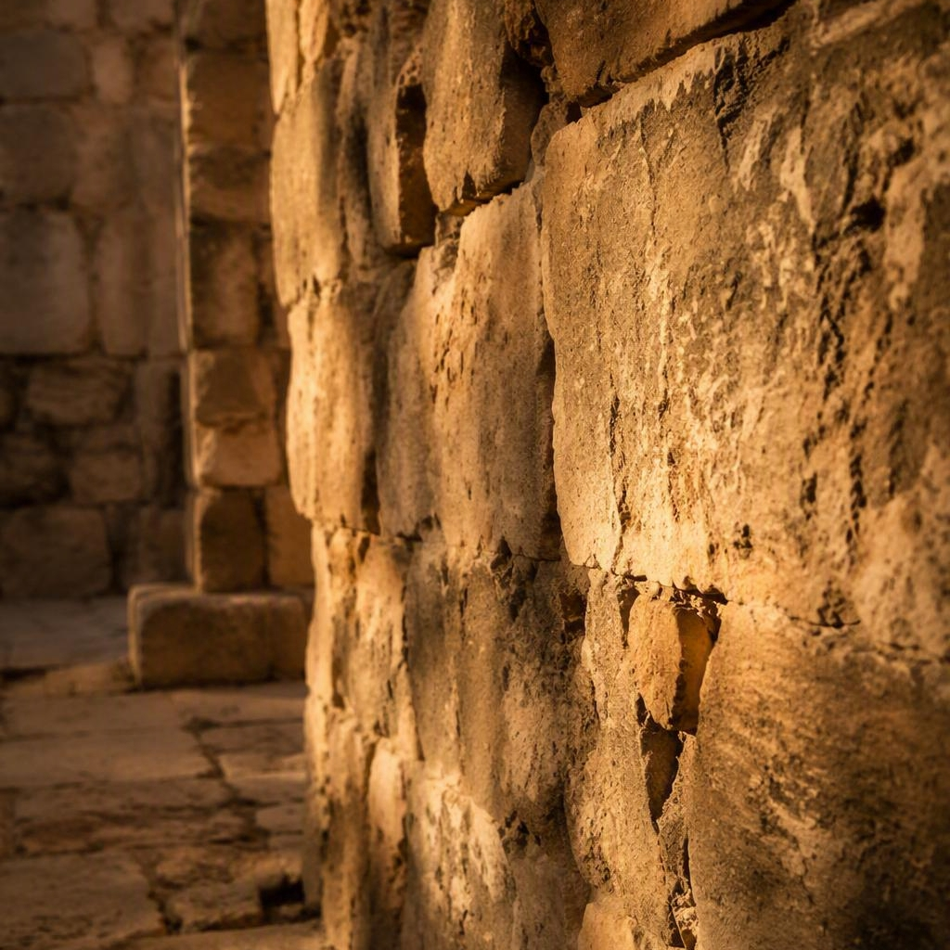
Guard the Faith
SECTION ONE
NOTES
Jude 3 (NKJV)
Beloved, while I was very diligent to write to you concerning our common salvation, I found it necessary to write to you exhorting you to contend earnestly for the faith which was once for all delivered to the saints.
2 Timothy 1:14 (NKJV)
That good thing which was committed to you, keep by the Holy Spirit who dwells in us.
CROSS-REFERENCES BY THEME
Guarding the deposit 1 Tim. 6:20 · 2 Tim. 1:13 · Titus 1:9
Defending the faith Gal. 1:6-9 · Phil. 1:27 · John 14:26

Slide 3

Stand Strong &
Live the Faith
SECTION TWO
NOTES
Romans 1:16 (NKJV)
For I am not ashamed of the gospel of Christ, for it is the power of God to salvation for everyone who believes.
Isaiah 40:31 (NKJV)
Those who wait on the Lord shall renew their strength; they shall mount up with wings like eagles, they shall run and not be weary.
1 John 4:4 (NKJV)
You are of God, little children, and have overcome them, because He who is in you is greater than he who is in the world.
Ephesians 5:15-16, 18 (NKJV)
See then that you walk circumspectly, not as fools but as wise, redeeming the time … but be filled with the Spirit.
CROSS-REFERENCES BY THEME
Unashamed of the gospel 1 Cor. 1:18 · 2 Tim. 1:8 · Mark 8:38
Strength that endures Isa. 41:10 · Ps. 27:14 · 2 Cor. 4:16
Overcoming in Christ Rom. 8:31 · John 16:33 · 1 John 5:4-5
Living wisely in the Spirit Col. 4:5 · Gal. 5:16 · Rom. 13:11-14

Slide 4

Contend & Live It Out
CLOSING CHALLENGE
APPLICATION FOR TODAY
Reflect
Where is my faith being tested, and am I standing firm or drifting?
What truth do I most need to guard and live out this week?
Act This Week
Speak one gospel truth to someone who needs encouragement.
Open Scripture daily to steady and strengthen your walk.
“…contend earnestly for the faith which was once for all delivered to the saints.”
Jude 3 (NKJV)
Stand & contend Jude 20-21 · 1 Cor. 16:13
Finish faithfully 2 Tim. 4:7 · Heb. 12:1-2
Reflect
What am I doing today to guard God's truth, grow in His strength, and faithfully live out my faith?

